Slide 1
Building Applications for Office 365 and SharePoint with React
Scot Hillier
scot@scothillier.net
@ScotHillier

Slide 2
Agenda
React Framework
SharePoint Framework

Slide 3
REACT Framework

Slide 4
Introducing React
React is a framework for building user interfaces
The framework reacts to state changes in the UI
Emphasizes component-based development
Lighter than other frameworks
Ideal for building web parts

Slide 5
React Fundamentals
Obtain the framework from a CDN or npm
https://cdnjs.cloudflare.com/ajax/libs/react/15.5.4/react.min.js
https://cdnjs.cloudflare.com/ajax/libs/react/15.5.4/react-dom.min.js
npm install react --save
npm install react-dom --save
React is the main entry point to APIs
ReactDOM used to render elements
React.DOM wraps standard HTML elements

Slide 6
Hello, World
<!DOCTYPE html>
<html>
<head>
<meta charset="utf-8" />
<title>React JavaScript Basics</title>
</head>
<body>
<div id="app"></div>
<!-- React Libraries -->
<script src="https://cdnjs.cloudflare.com/ajax/libs/react/15.5.4/react.min.js"></script>
<script src="https://cdnjs.cloudflare.com/ajax/libs/react/15.5.4/react-dom.min.js"></script>
<script>
ReactDOM.render(React.DOM.h1(null, "Hello, React!"), document.getElementById("app"));
</script>
</body>
</html>

Slide 7
React Components
A custom class extending React.Component
Render method returns a React component
Immutable props for component configuration
Changeable state used to render component

Slide 8
ES5 Component
var Component = React.createClass(
{
propTypes: { message: React.PropTypes.string },
getDefaultProps: function() { return { message: "I don't know what to say!" }},
getInitialState: function() { return { text: this.props.message}},
updateTextState: function(newText) { this.setState({ text: "Thank you!" })},
render: function () {
return React.DOM.h1({onClick: this.updateTextState}, this.state.text);
}
}
);
ReactDOM.render(
React.createElement(Component,
{ message: "Click on my first component" }), document.getElementById("app"));

Slide 9
ES2015 Component
class Component extends React.Component {
constructor(props) {
super(props);
this.state = { text: props.message };
this.updateTextState = this.updateTextState.bind(this);
}
render() { return React.DOM.h1(
{ onClick: this.updateTextState },
this.state.text); }
updateTextState(newText) { this.setState({ text: "Thank you!" }); }
}

Slide 10
Utilizing JSX
JSX is a preprocessor step that adds XML syntax to JavaScript
It is optional, but very useful for organizing components
It requires a transpiler like Babel or TypeScript
The following are equivalent:
ReactDOM.render(
React.createElement(Component, { message: "My first component" }),
document.getElementById("app"));
ReactDOM.render(
<Component message="My first component" />,
document.getElementById("app"));

Slide 11
Component Lifecycle
componentWillUpdate
executed before component is rendered
componentDidUpdate
executed after component is rendered
componentWillMount
executed before node is added to the DOM
componentDidMount
executed after node is added to the DOM
componentWillUnmount
executed before node is removed from the DOM
shouldComponentUpdate(newProps, newState)
executed before component is updated

Slide 12
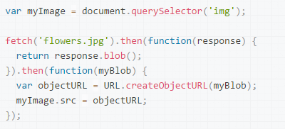
fetch()
Promise-based network requests
Supported natively by Chrome 49 and above
Supported by TypeScript for other browsers

Slide 13
Asychronous Calls and State Update
public componentDidMount(): void {
fetch(
'../../_api/web/currentuser',
{
method: 'GET',
credentials: 'same-origin',
headers: {
'accept': 'application/json'
}
}
).then(response => {
return response.json();
}).then(json => {
console.log(json);
this.setState({ data: json.Title, isValid: true });
}).catch(e => {
console.log(e);
});
}
Critical for SharePoint

Slide 14
Event Handling
constructor(props: IMyProps){
super(props);
this.state.value = props.value;
this.changed = this.changed.bind(this);
}
public render(): React.ReactElement<any> {
return (<div className={ this.className }>
<input onChange={this.changed} type="text“
value={this.state.value} />
</div>);
}
public changed(event): void {
var newValue: string = event.target.value;
event.stopPropagation();
event.nativeEvent.stopImmediatePropagation();
}
Be sure to bind ‘this’
Designate handler
Implement handler
Stop bubbling
Stop other handlers

Slide 15
DEMO
React Framework

Slide 16
SharePoint framework

Slide 17
Development Environment
Office 365 Tenancy
Office Developer Program
App Catalog Developer Site Collection
Upload SharePoint Workbench
Visual Studio 2015
Complete previous setup steps Yeoman Generator, Gulp, and SharePoint Generator
npm install -g yo gulp
npm i -g @microsoft/generator-sharepoint

Slide 18
Key Concepts
Codifies the JavaScript embed pattern
Runs in the context of the current user
Hosted in a referenced CDN
Works with new page experience or classic page experience

Slide 19
Development Flow
Generate Scaffolding
Package
Write Code
Deploy to CDN
Test in local Workbench
Upload to App Catalog
Test in SP Workbench
App Web Part to Page

Slide 20
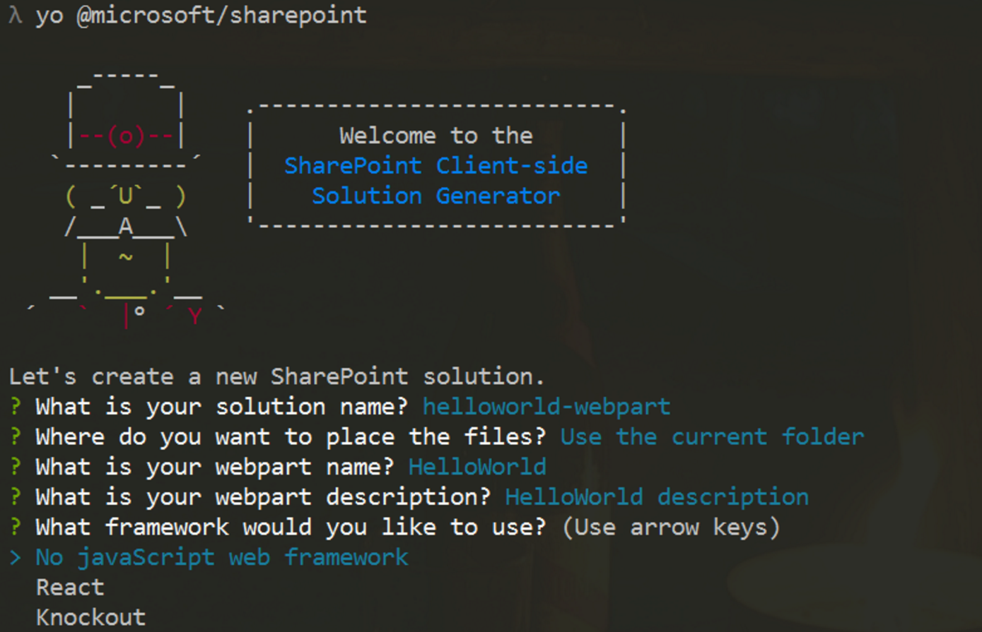
Generate Scaffolding
Yeoman Generator
Creates initial project files
React and KO built-in
Angular requires manual steps
yo @microsoft/sharepoint
Visual Studio Code
Open created project for editing

Slide 21
Write Code
export default class MyFirstKoWebPartWebPart extends
BaseClientSideWebPart<IMyFirstKoWebPartWebPartProps> {}
Framework extends a react js component to render HTML output
public render(): void {
}

Slide 22
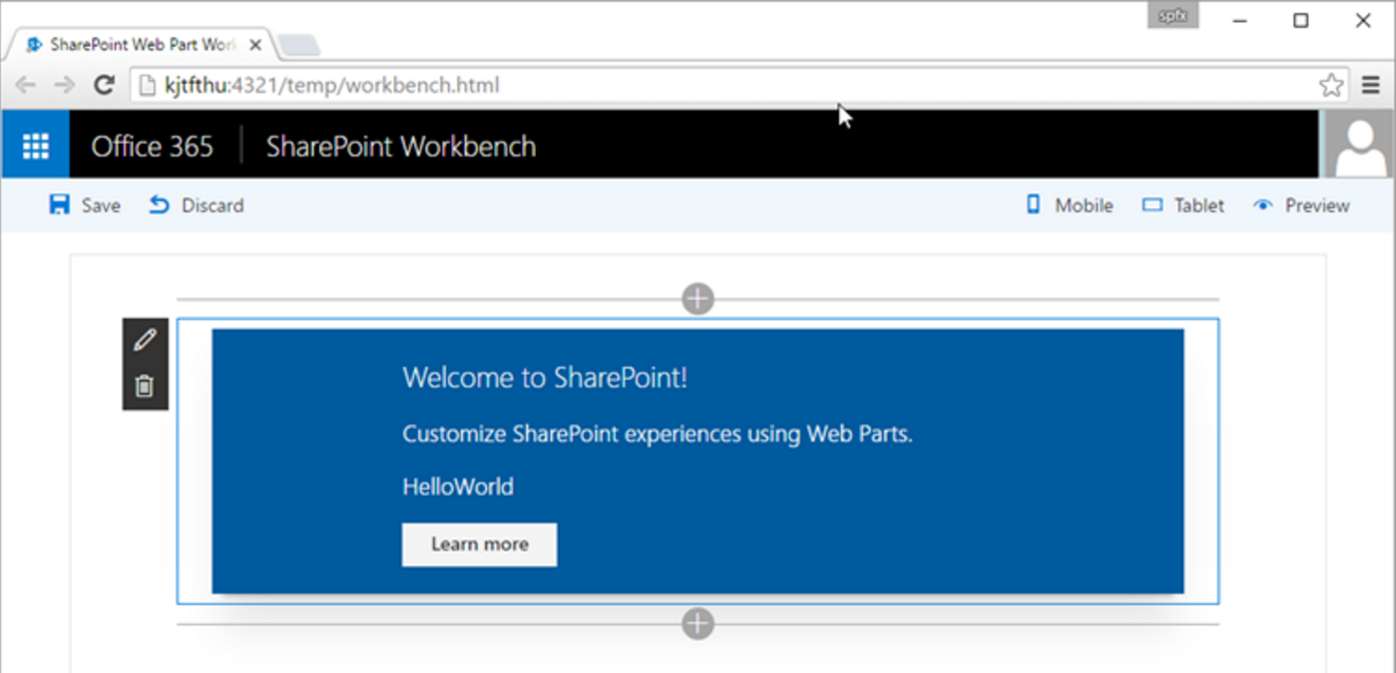
Test in Workbench
Local
For local testing
Office 365
Runs in the SharePoint context

Slide 23
Deployment
CDN Support
gulp package-solution
Deploy assets to CDN from directory in prepare-deploy.json file
Reference in write-manifests.json file
SharePoint
Create SPAPP package
Upload to App Catalog
Add to App and Web Part to site
"deployCdnPath": "temp/deploy"
"cdnBasePath": "https://[MYOFFICE365].sharepoint.com/SiteAssets/"

Slide 24
DEMO
SharePoint Framework

Slide 25
Summary
React Framework
SharePoint Framework

Slide 26
Questions?
Please use Events XD (EventBoard) to fill out a session evaluation.
Thank you!

